Slide 1


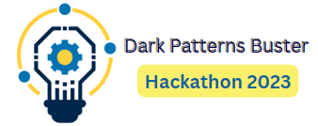



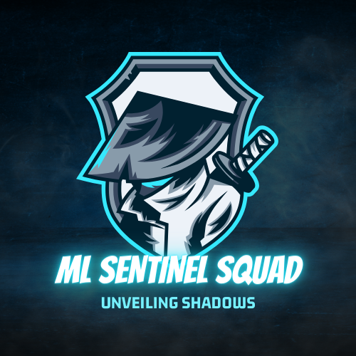
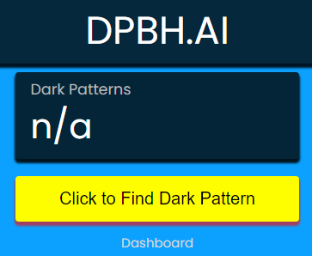
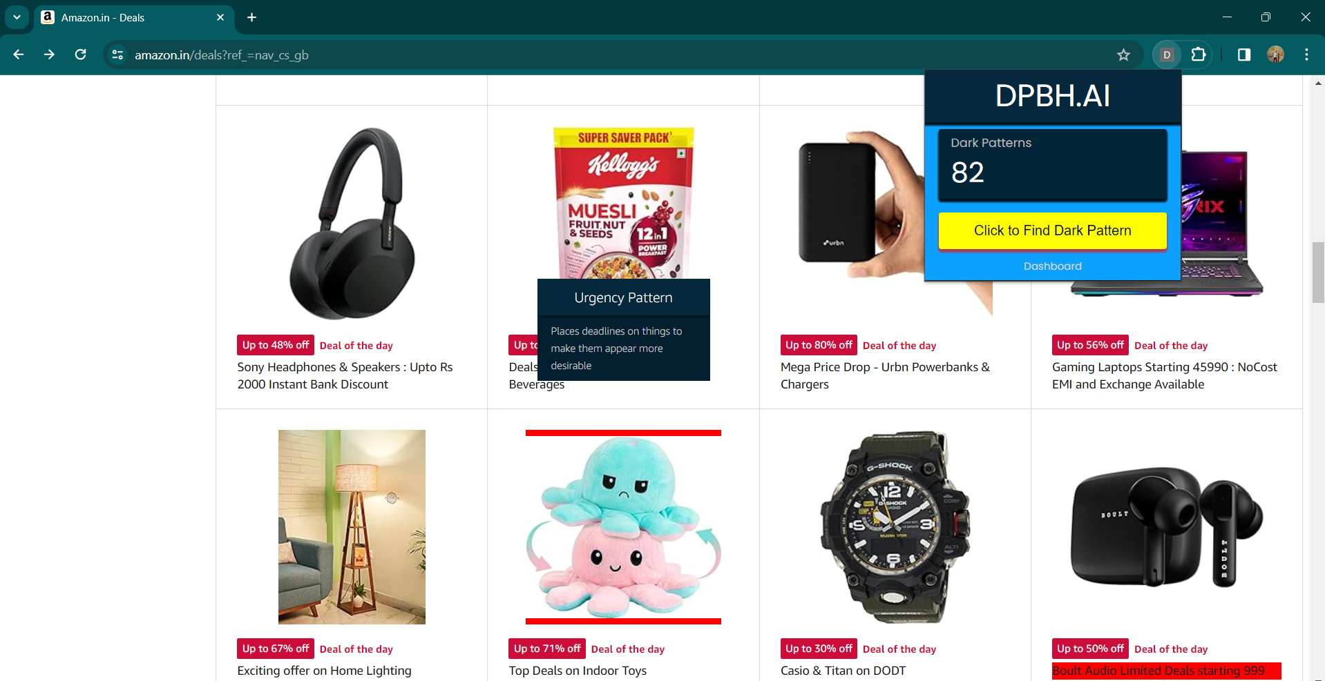
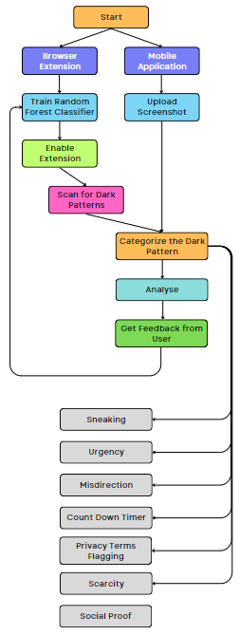
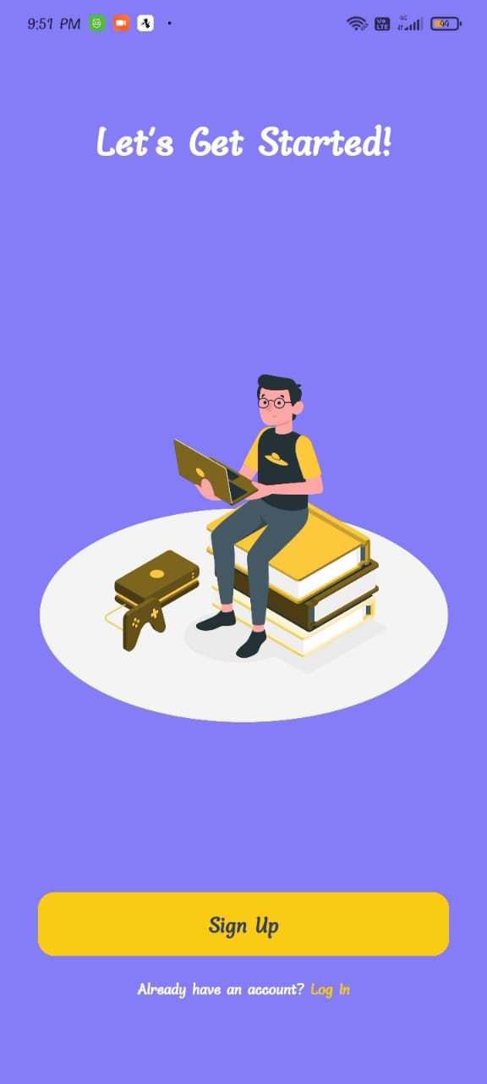
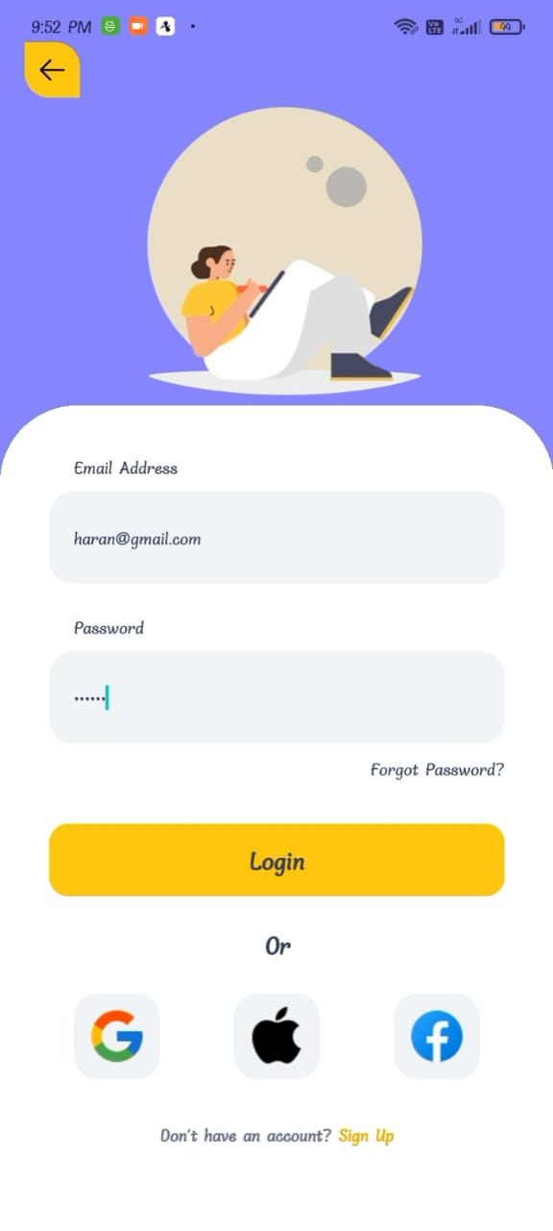
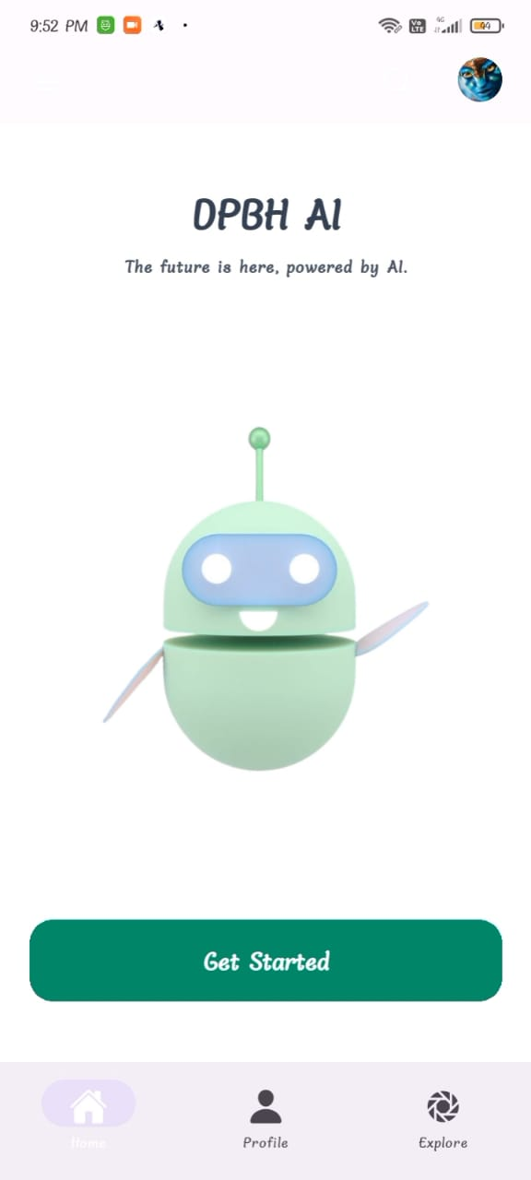
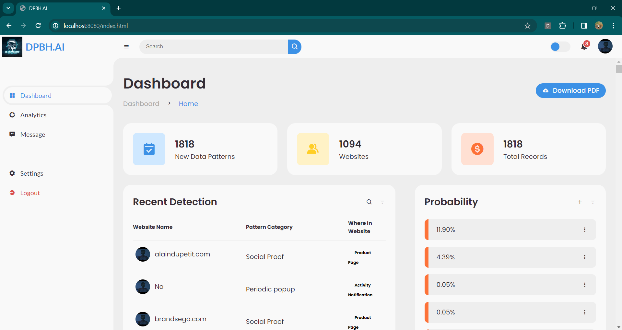
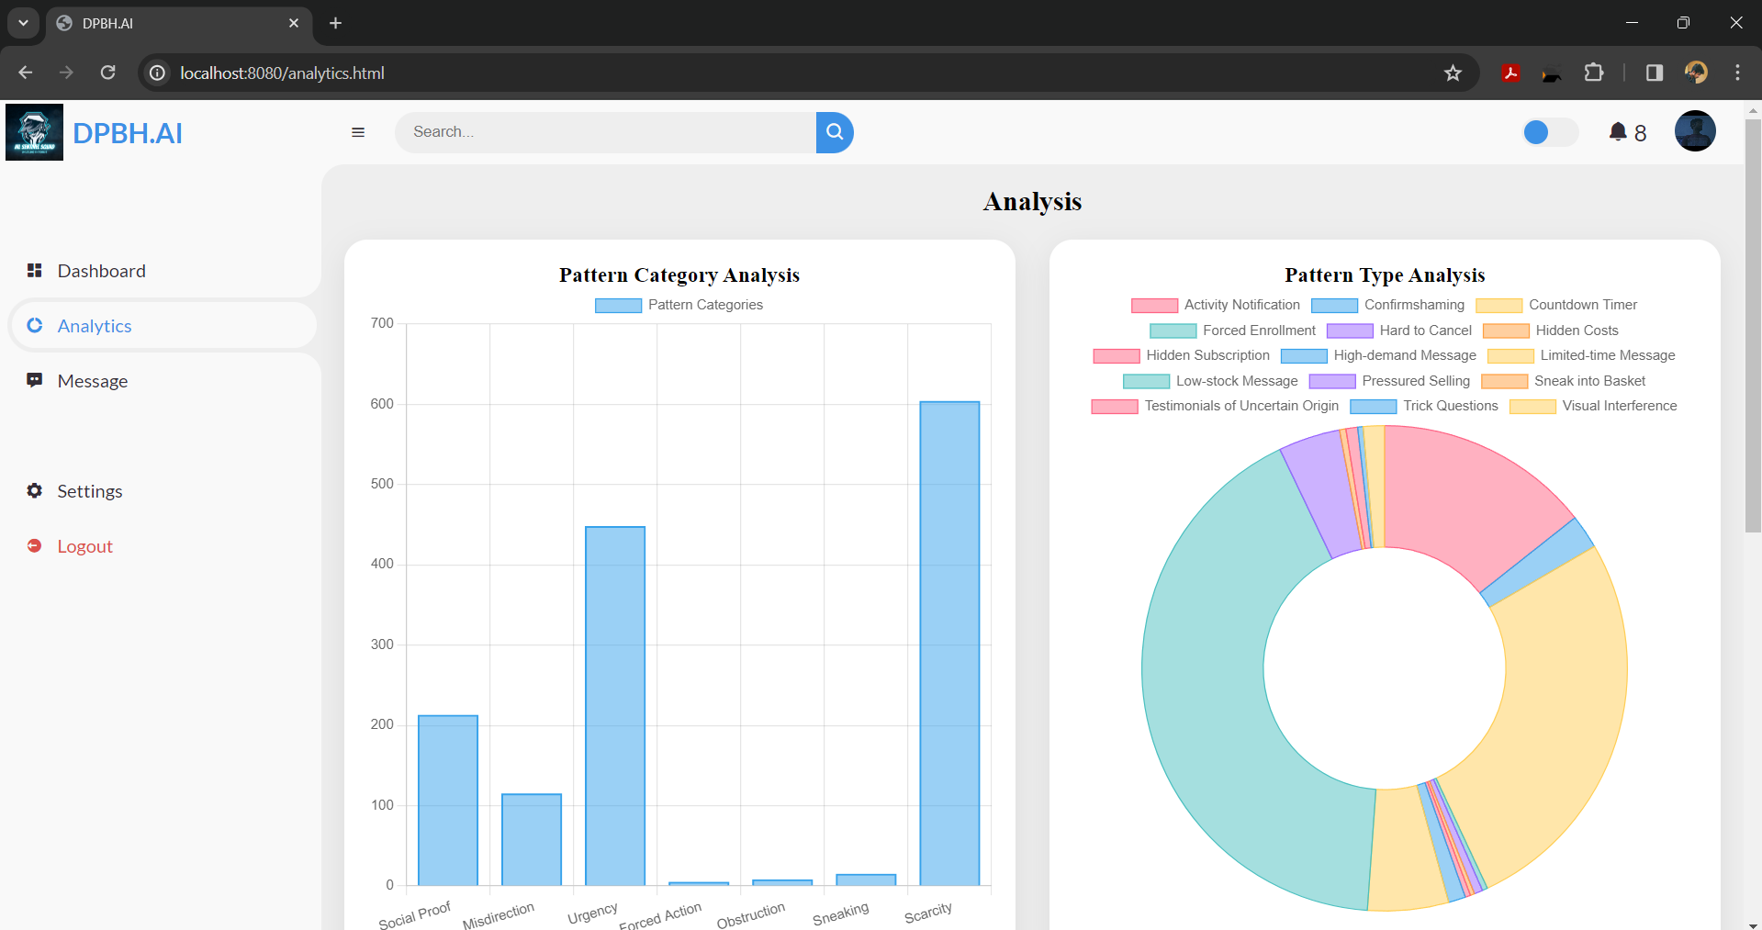
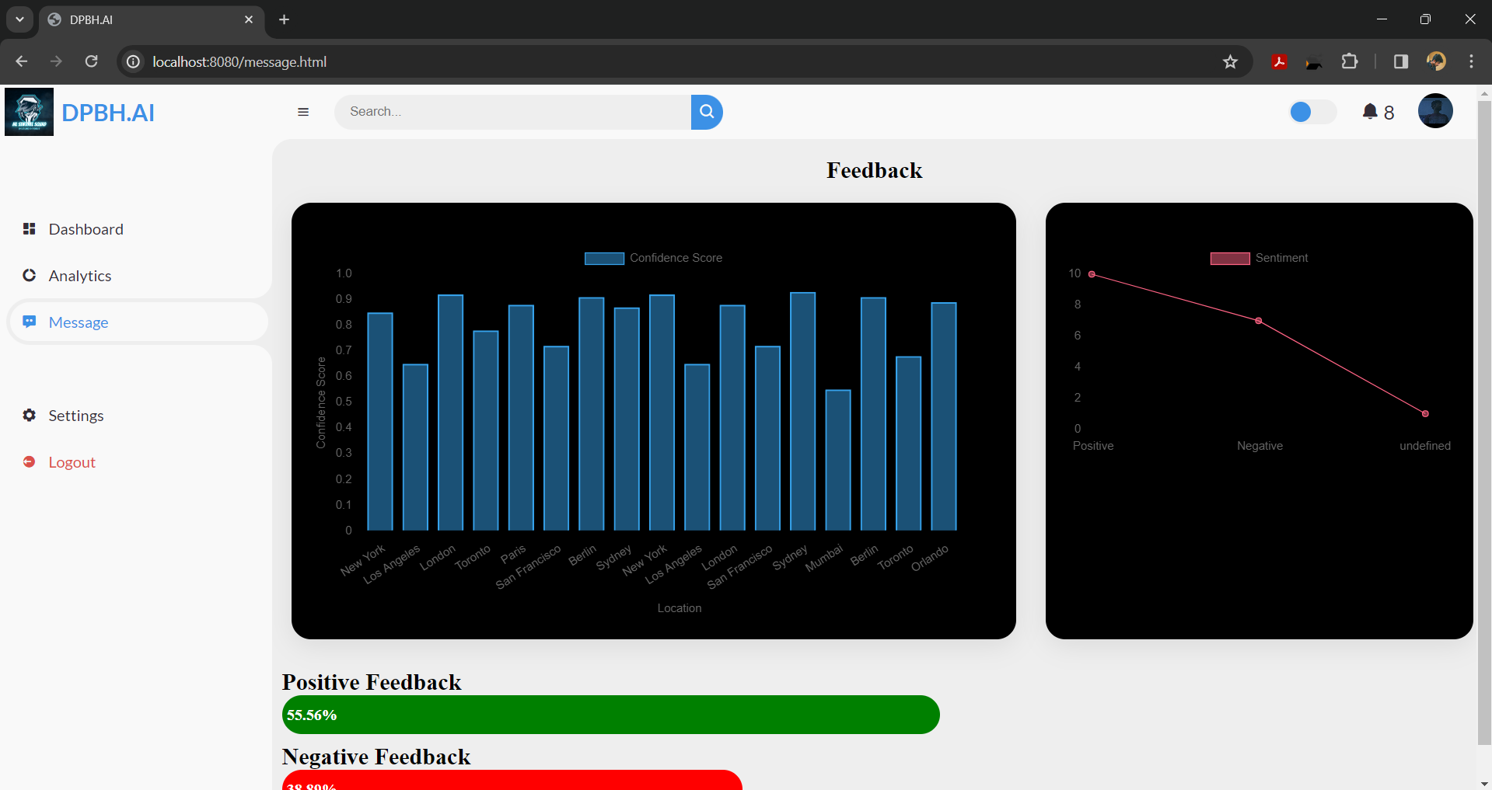
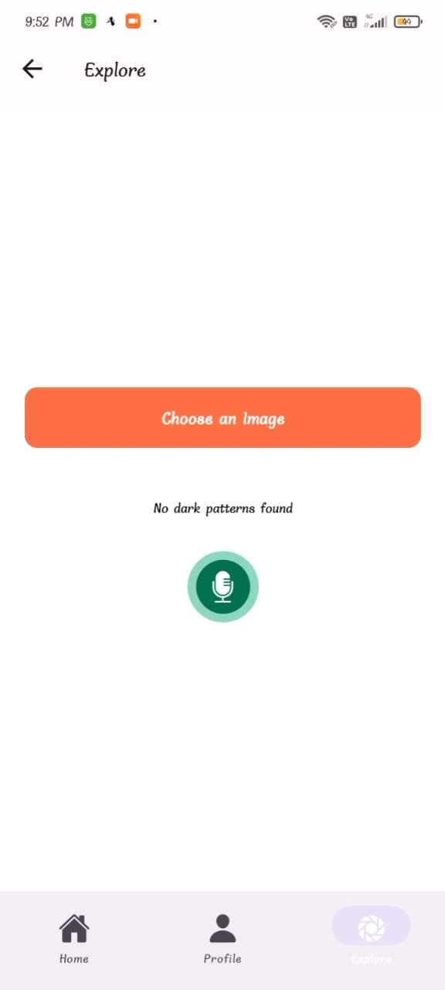
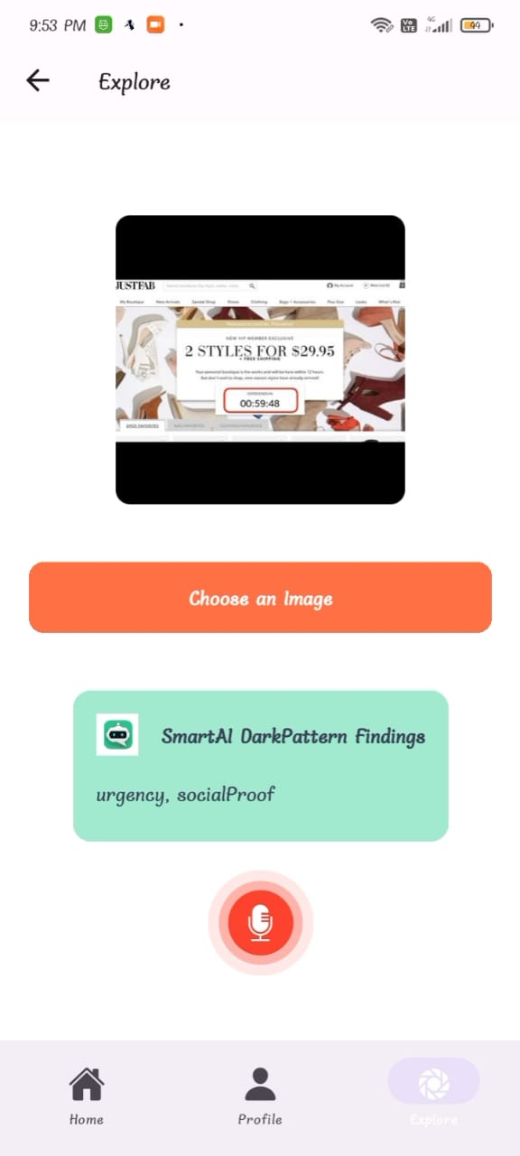
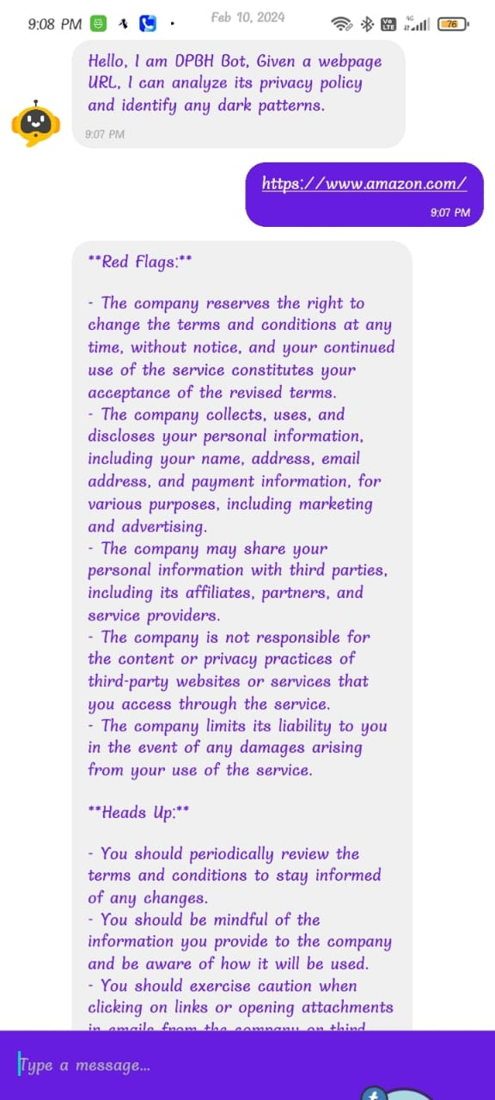

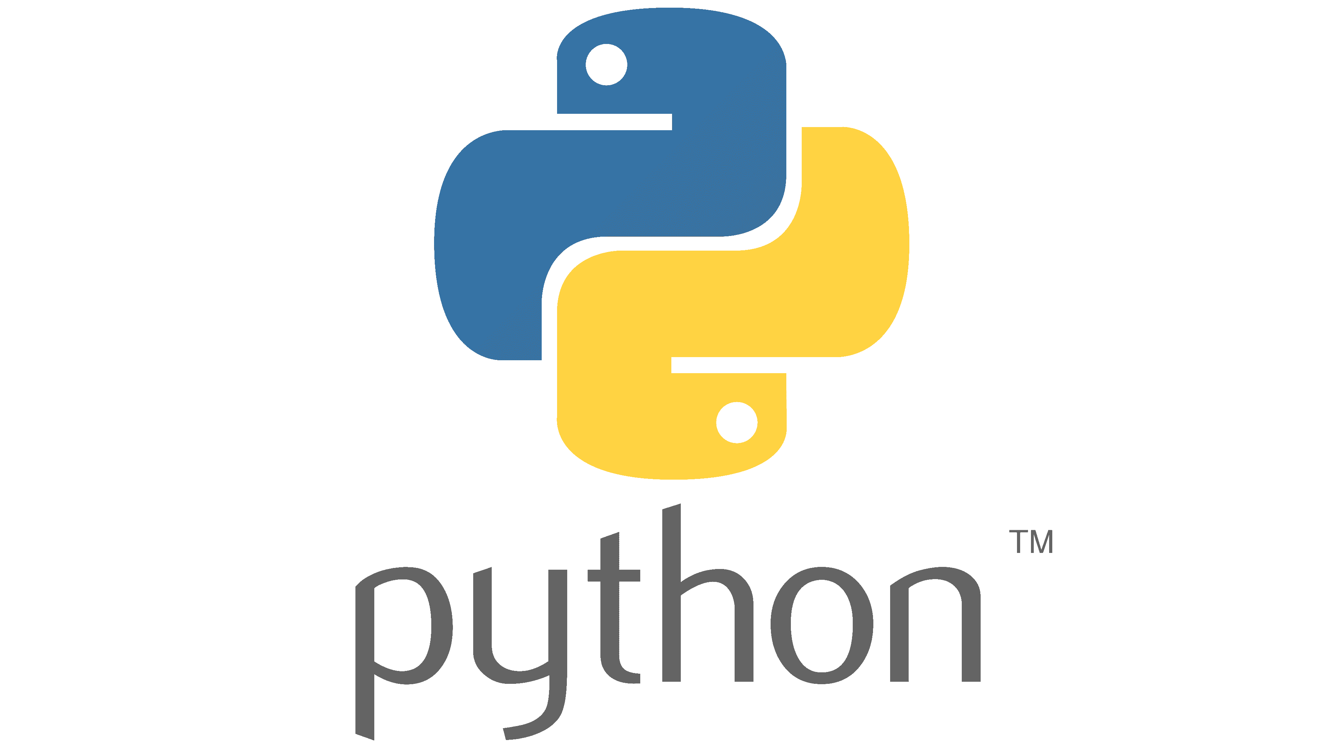


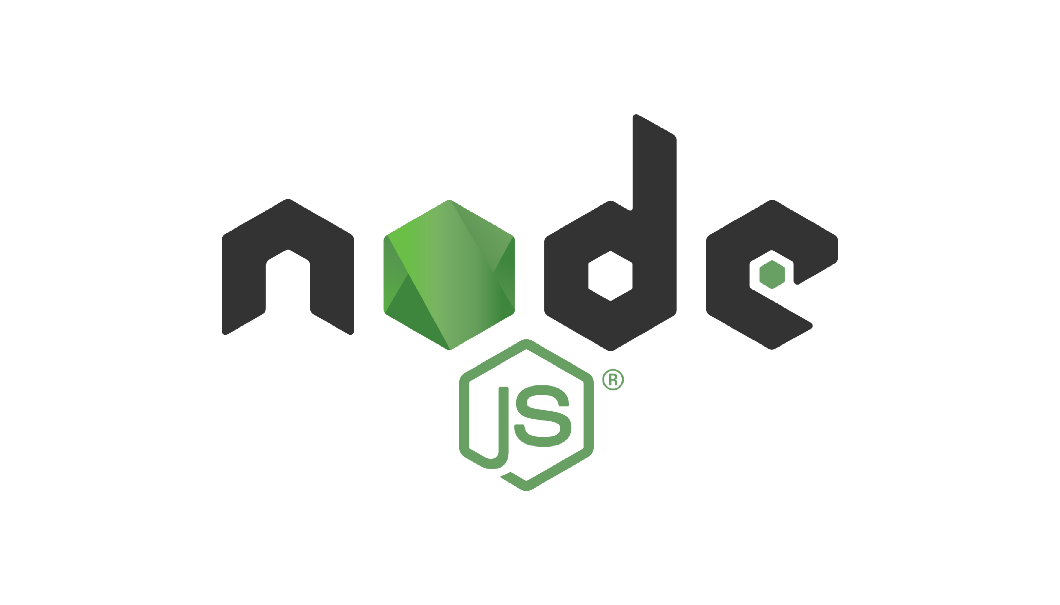







Dark Patterns Buster Hackathon (DPBH-2023)
Round 3 Grand Finale @ IIT(BHU), Varanasi
Coimbatore Institute of Technology | ML SENTINEL SQUAD | T Bala Saatvik K Hariharan T Kavin S Kaviyarasu R Koushic
(Feb.17, 2024)
Browser Extension
Mobile Application
Browser Extension UI
Dark Patterns
WorkFlow
Mobile App UI with Chatbot
Urgency Pattern
Detected
Dashboard
Dark Patterns Detected
Sneaking
Urgency
Misdirection
Count Down Timer
Privacy Terms Flagging
Scarcity
Social Proof
Technology Stack
Features
Detecting and Categorising Dark Patterns
Blurring Dark Patterns
Analysing the History of Dark Patterns
Receiving Feedback from Users
Retraining the model and Improving the Accuracy
Gemini API to analyse Screenshots
NLP Voice Enabled Bot
Privacy Policy Analysis
Dark Pattern
Importance
Hierarchy
Browser Compatibility
OS Compatibility
Sneaking
Urgency
Misdirection
Count
Down
Timer
Privacy Terms Flagging
Scarcity
Social Proof
Contact:
T Bala Saatvik
71762108005@cit.edu.in
Dr. N. S Rajput
Convener, DPBH-2023
Email: dpbh2023@iitbhu.ac.in
© All rights reserved

Slide 2


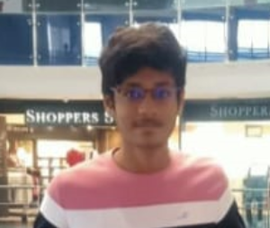
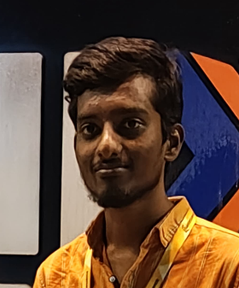

Abstract
Introducing our comprehensive solution: a cutting-edge project designed to combat dark patterns, those deceptive user interface designs that manipulate users into taking actions they might not otherwise choose. Leveraging the power of machine learning and user-friendly interfaces, our project offers multi-faceted detection and reporting capabilities. At its core lies an advanced algorithm based on the random forest model, meticulously trained to identify various dark patterns prevalent across websites. Our system pinpoints patterns such as scarcity, misdirection, and urgency, illuminating these deceptive practices with pinpoint accuracy. But we didn't stop there. We've crafted an intuitive dashboard, providing insightful statistics and visualizations of detected dark patterns within webpages. This standalone file offers a comprehensive overview, empowering users with actionable insights into the prevalence and impact of dark patterns.
Moreover, accessibility is key. With our React Native app, users can effortlessly identify dark patterns on-the-go. Simply upload a screenshot, and our Gemini-Pro-powered algorithm goes to work, highlighting any detected deceptive elements with precision. For those seeking real-time analysis and guidance, our voice-enabled chatbot steps in. Seamlessly integrated with natural language processing capabilities, users can simply provide a website URL, and our chatbot fetches the entire page, pinpointing dark patterns and suggesting actionable steps to mitigate their influence. In a digital landscape increasingly plagued by deceptive design practices, our project stands as a beacon of transparency and empowerment, equipping users with the tools and knowledge needed to navigate the web with confidence.
Team Members
T Bala Saatvik
Backend Developer
R Koushic
UI UX Developer
T Kavin
Mobile App Developer
S Kaviyarasu Dashboard Designer
K Hariharan Deployment Manager
Impact Assessment & Conclusion
Solution Highlights
Our browser extension, mobile app, and NLP bot empower users to identify and combat deceptive e-commerce practices. With precise detection of dark patterns, our tools enhance awareness and support informed decision-making. By fostering ethical design and accountability, our solution promotes transparency and trust between consumers and businesses, leading to a fairer online shopping experience.
Our project introduces a browser extension and a React Native app, providing users with effective tools to combat dark patterns. With the browser extension, our solution empowers users to identify and avoid deceptive design practices seamlessly, while the React Native app offers on-the-go detection, allowing users to upload screenshots for precise identification of dark patterns.

